Slide 1
Public Disclosure
WMD Employees

Slide 2
What is the Public Records Act?
What are public records?
How does it affect me?
What should I do now?

Slide 3
WA State Public Records Act RCW 42.56
State law which requires all agencies to:
Respond within 5 business days
(Starts the day after a request comes in)
Make agency records available to the public
Leans towards transparency
Provide the fullest assistance to requestors

Slide 4
RCW 42.56
Within 5 Business Days ALL public agencies (local, state, education) must respond to a request by choosing one of:
(a) Providing the record;
(b) Providing an internet address and link on the agency's web site to the specific records requested, except that if the requester notifies the agency that he or she cannot access the records through the internet, then the agency must provide copies of the record or allow the requester to view copies using an agency computer;
(c) Acknowledging that the agency, has received the request and providing a reasonable estimate of the time the agency, will require to respond to the request; - See Case Law! Respond with a date of Installment.
(d) Acknowledging that the agency, has received the request and asking the requestor to provide clarification for a request that is unclear, and providing, a reasonable estimate of the time the agency, will require to respond to the request if it is not clarified; or
(e) Denying the public record request.

Slide 5
What is a public record???
Simple definition:
All documents/recordings/notes/files/databases/videos/text messages/pdfs./maps/calendars/emails/etc. that an agency creates, uses, accesses, maintains, complies, references, reports, etc.
Essentially anything you do in your job creates a record.

Slide 6
What is a Public Records Request???
Question:
How many counties had active fires on August 13, 2017?
How many kids are enrolled at WYA this year?
I’d like to verify if Comcast submitted a bid for the GS-005-08 RFP.
Where can I request funding information?
REQUEST:
I would like a copy of the most recent report on the WMD Budget projections.
I’m looking for all emails to or from Mike Strover in the last 6 months.
Send me all funding requests regarding the Diamond Creek Fire from 7/1/2017 to 7/31/2017.
I want all the applications and scoring for the Maintenance Mechanic position posted 5/1/2014.

Slide 7
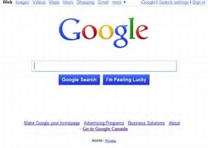
It’s Not a Request if…
Records, forms or publications such as industry guides are located on the agency website – we can provide the internet link
Records located on the world wide web – (Google it)
Records located on another state agency website – OFM, WaTech, WSDOT

Slide 8
Who can request records?
Anyone!
Most common:
Attorneys
Business Owners
Media
Individuals of the Public
Students
Conspiracy Theorists
Bloggers
There is no legal description that limits who a requester may be.
Note: there is an entire industry based on litigating Public Records Requests!

Slide 9
What is Protected?
The Public Records Act contains several hundred exemptions:
Employee home address, personal email addresses, personal phone number, etc.
Applications for employment
Active employee investigations
Attorney/ Client privilege conversation
Security – passwords, infrastructure, system vulnerabilities, etc.
Social Security Numbers, Tax ID Numbers, etc.
Federal statutes – WYA (FERPA)

Slide 10
What is Not Protected?
Confidential sections of bid proposals
Disciplinary actions of employees
Rude emails – oopsie!
Employee investigations once they are closed.

Slide 11
Caution
Be careful what you say in email! What you do today can be on King5 News tomorrow.
When in doubt or if you need to vent, pick up the phone!
Once you are aware of an active request, DO NOT delete records, even if they are past retention. (Punishable under RCW 40.16.010 and WAC 292-120-020 = Class C Felony.)

Slide 12
How does a Request come in?
The request should come to IGA&P (Public Records Officer) via:
Public Portal on our website
Public Records Inbox public.records@mil.wa.gov
Hard copy mail
Employees can receive requests too – in person, email, etc.

Slide 13
WHAT? I can receive a request??
In a meeting
Phone call
During conversation
Email

Slide 14
Hot Potato!
If an employee receives a request –
Immediately forward request to the Public Records Officer
public.records@mil.wa.gov
253-512-8110

Slide 15
… and the clock starts ticking!
Agency (Public Records Officer) has 5 business days to formally acknowledge request and provide a estimate of time needed to provide the records.
WMD works 4 days/ week = We already lost 1 full day!

Slide 16
How does a Request affect me?
Public Records Officer may call you or email you if you are likely to have the records in question.
The Public Records Portal – GovQA – will email you with Activities to complete. These emails provide links where you can copy the records you have, add notes, and record the time it took you to complete the Activity.

Slide 17
Junk mail

Slide 18
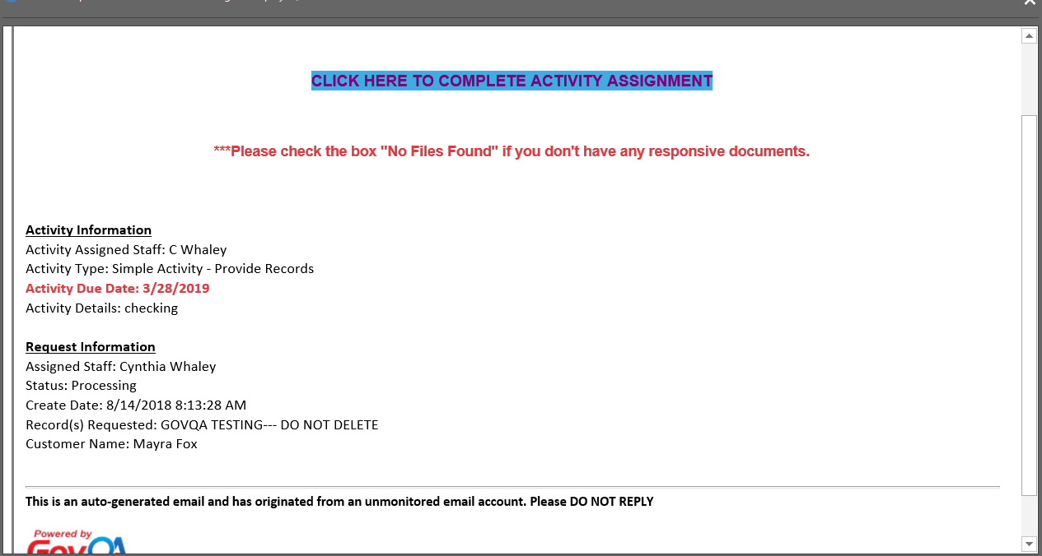

Slide 19
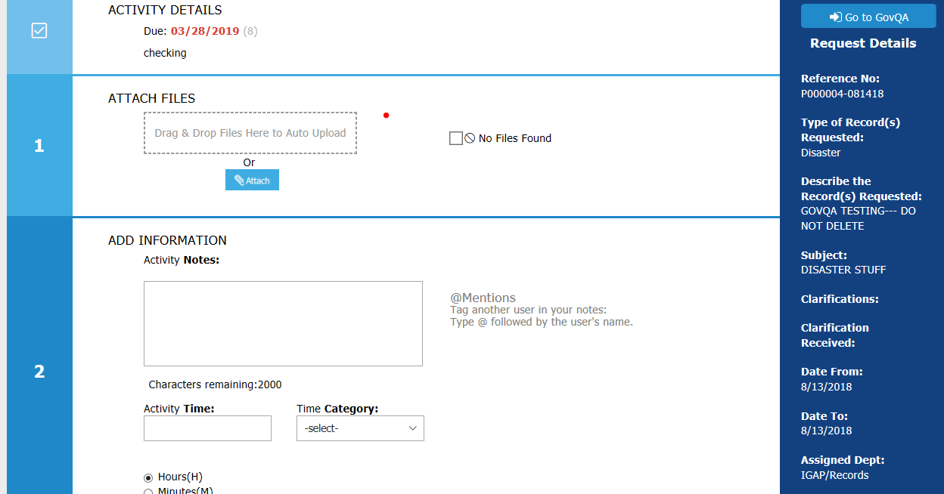

Slide 20
What Are the Risks?
Missed requests – request found within another document, i.e., in an email that got missed.
Verbal request - unrecognized
Failed to send all or correct records being requested
Untimely response – didn’t respond within 5 business days
Inadequate search for records – includes Text Messages!
Withholding records without a statutory exemption
Statute of limitations is 364 days after request has been closed

Slide 21
Case Law
Wades Gun Shop v. Dept. of Labor & Industries – Penalties can be awarded on a per pages basis (defines the term “record” to include a single page). L&I violated the PRA in 5 separate occurrences during 1 request . Penalties were imposed each time for a total of $546,509.26.
O’Neill v. City of Shoreline – Affirmed access to metadata i.e. keeping documents in native format. A document was sent from a home computer by a city employee who later changed the format hiding the documents origins. The City of Shoreline was fined $538,555, plus its own legal fees for a 7 year lawsuit.

Slide 22
More Case Law…Nissen v. Pierce County
2 Requests
8 years in court
$950,000 to Glenda Nissen, requester
+ prior legal costs and attorney fees = $2.35 Million
This case involved two requests for public records that Glenda Nissen, a sheriff's detective, sent to Pierce County (County). Both requests asked for records related to Pierce County Prosecutor Mark Lindquist.
The telephone number identified in these requests was connected to Lindquist's private cell phone.
The County reviewed call and text message logs and disclosed partially redacted copies to Nissen.
The redactions concealed line items for calls and text messages that Lindquist self-described as personal in nature.

Slide 23
Nissen v. Pierce County continued
The County did not produce the contents of any text message, however, though copies of them existed on the service provider Verizon' s servers.
The messages revealed Lindquist’s attempts to manipulate online reactions to a news story regarding Nissen.
Dissatisfied with the County's disclosures, Nissen sued the County, seeking an in camera review of Lindquist's text messages and the call and text message logs to determine if all of the information was a public record.
Applying the Public Record Act's (PRA) definition of "public record," the Court of Appeals held that Lindquist's text messages were public records because he "prepared" them in his official capacity.
The Supreme Court affirmed the Court of Appeals in part. Records that an agency employee prepares, owns, uses, or retains on a private cell phone within the scope of employment can be "public records" of the agency under RCW 42.56.010(3).
A second lower-court order required disclosure of nine more text messages and found Lindquist had violated the state public Records Act. Primarily, they revealed petty office gossip among subordinates.

Slide 24
What to do with your Records if you receive a Request
If you receive notice of a request for records – DO NOT delete anything that might be a responsive record. Even if the retention period is past.
Employees could be asked to sign Affidavits or Declarations for Court.
The Public Records Officer can search Email, Servers, SharePoint, OneDrive, Skype. They may need your help in identifying the correct search terms.
You may be asked to sign an affidavit verifying you searched for text messages.

Slide 25
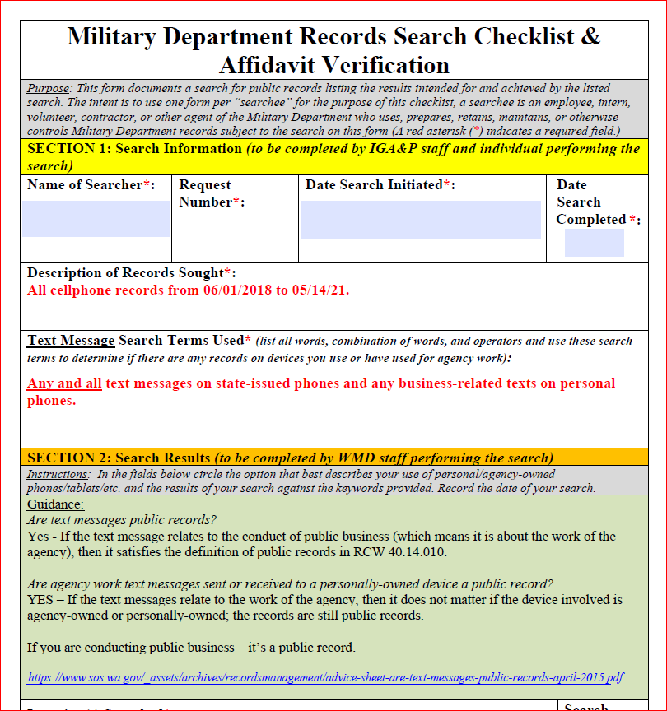
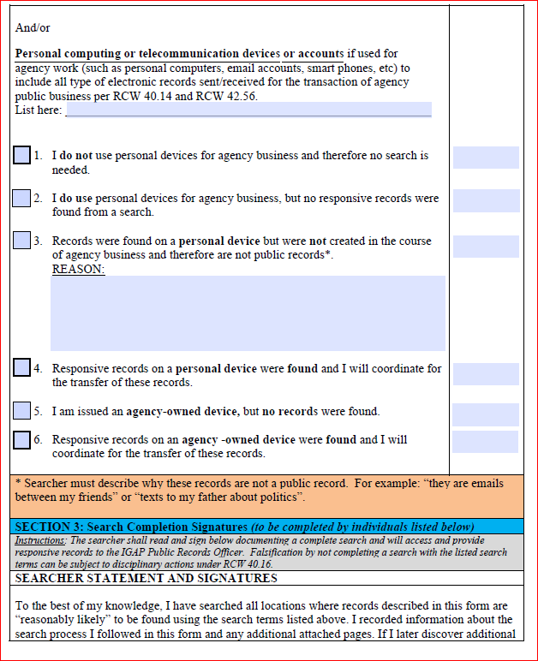

Slide 26
But do I have to keep everything?
Short answer: No!
Sort and file your work – it will save you time and headaches.
Many records may only be important for a short time – transitory.
emails just for checking-in (I’m running late) (thanks for your help),
all-staff notices,
quick notes from a meeting,
print-outs from a meeting PowerPoint,
drafts (once you have the final product), etc.
You can delete these records once their purpose is done.

Slide 27
What Should I Keep?
Learn to know and identify important records that show government actions: projects, contracts, negotiations, investigations, etc.
Retention Schedules define the length of time needed before you may either destroy a record or send it to State Archives.
Look to your friendly Records Coordinator and/or Records Officer for help understanding the State Retention Schedules.
If in doubt – Just ask us!

Slide 28
Everything you do makes a record.
What does a public records request looks like?
Tell the Public Records Officer immediately.
Take responsibility for your own records management.
Provide the Public Records Officer with help if needed.

