Slide 1
MICROSOFT 0365
eDiscovery Intro

Slide 2
What is it??
It’s SharePoint, Outlook, Skype, Teams, and OneDrive
Its in the Cloud
Its accessible anywhere with internet
Its searchable
“Living” Holds (similar to Litigation Holds but Not)
Export records from 0365

Slide 3
Who can use e-Discovery?
Anyone in the agency with a E-5 or G-5 license and permissions to the Security and Compliance Center.

Slide 4
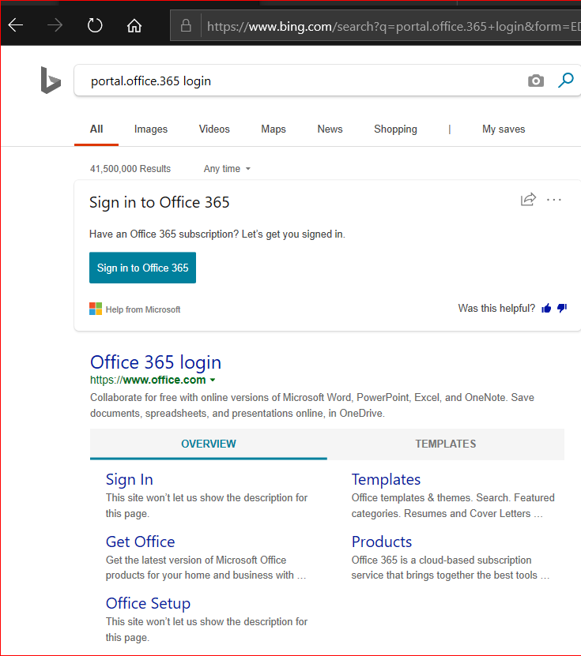
How do I access 0365?
Open search engine (suggested Edge or I.E)
Search portal.office.365 login

Slide 5
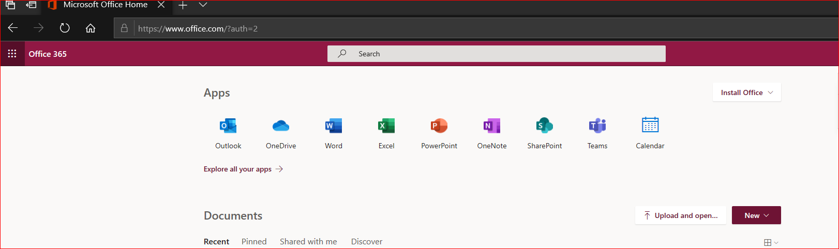
Dashboard

Slide 6
Navigate to Apps for e-Discovery tool

Slide 7
Select Security & Compliance Center

Slide 8
Select eDiscovery

Slide 9
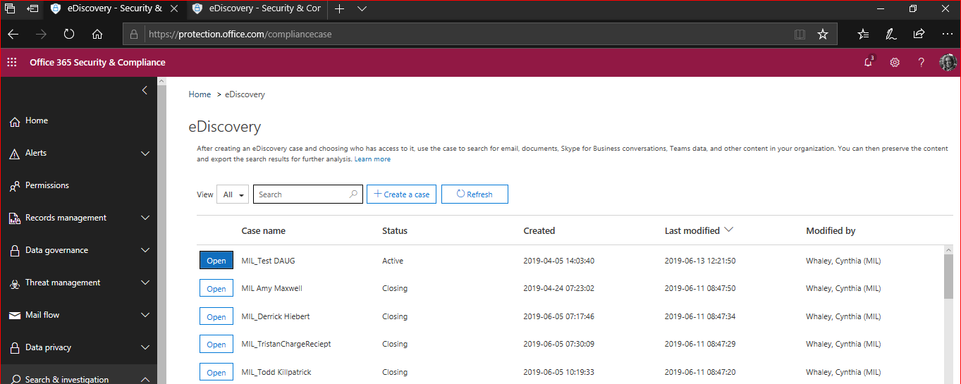
eDiscovery Dashboard
Note: agencies must identify their cases by acronym

Slide 10
Select +Create a case

Slide 11
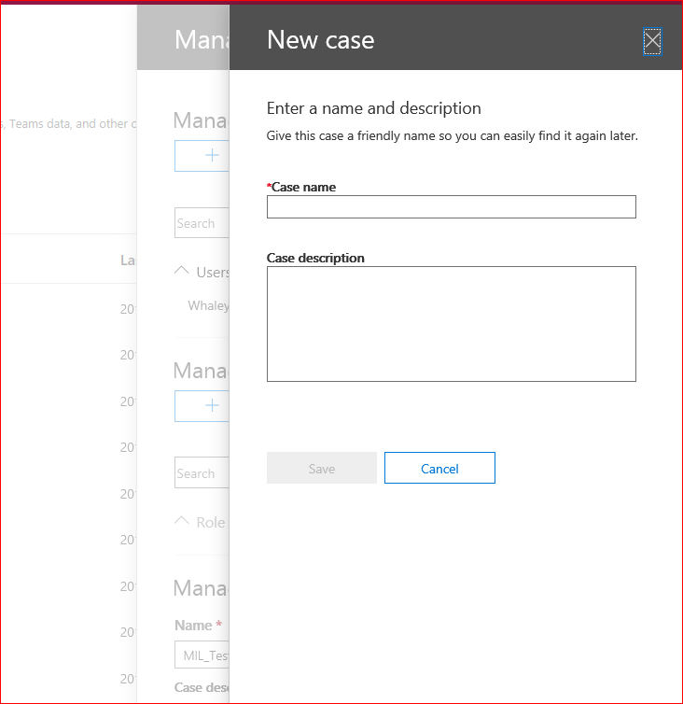
Creating a new case.
Note: Case names must have an agency's acronym as well as a unique name. Names cannot be re-used or duplicated throughout the entire eDiscovery platform, regardless of the Case. Ever.
255 character name limit

Slide 12
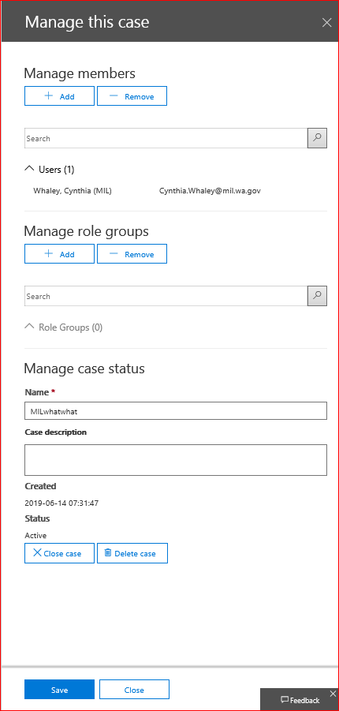
Options to add Members and Roles

Slide 13
Holds: used to place content on hold from retention policies. Because 0365 is in current time, it will continually look for new content matching the Hold. Useful for placing holds on large amounts of data (example: all records regarding traffic cones) or if you need an entire mailbox on hold (example: employee investigation). Because of the continual searching, it may not be the best choice for a Litigation Hold as currently understood and utilized.

Slide 14
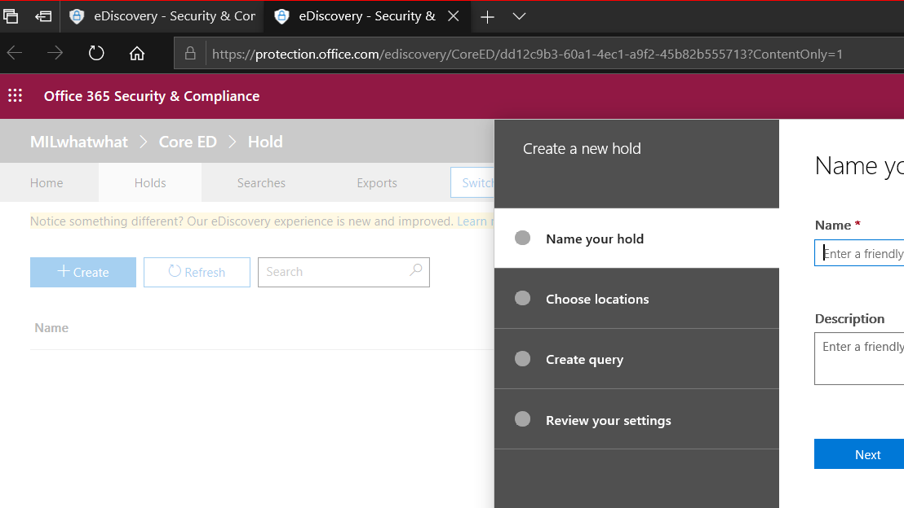
Creating a Hold
You are able to Name the Hold,
Choose where (SharePoint, OneDrive, Email) and
Determine the specific information to target.
Determine specific parameters or choose all.
Run searches specifically against the Hold(s).

Slide 15

More Hold Information…
Holds preserve data expiration while running long search investigations.
Holds can take 24 hrs. to take effect
Max of 10,000 holds across all eDiscovery cases
You cannot run a search and decide to place a hold on the results – it is not retroactive!
“The number of items on hold also includes unindexed items found in the content locations. Note that if you create a query-based hold, all unindexed items in the content locations are placed on hold. This includes unindexed items that don't match the search criteria of a query-based hold and unindexed items that might fall outside of a date range condition”. Microsoft
After 5 Holds on 1 mailbox, the entire mailbox will automatically be on Hold until 1 Hold is removed.
Cannot place a Hold on ALL agency mailboxes at one time (you can run a search on ALL mailboxes)

Slide 16
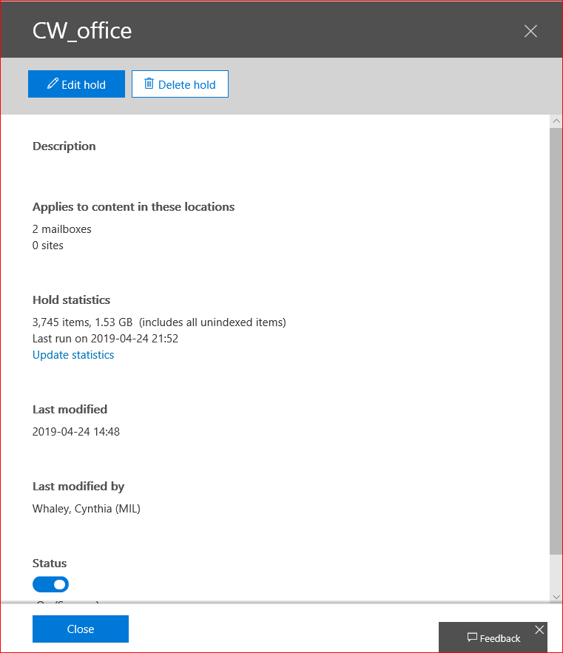
After running a Hold, you can see statistics on the results.

Slide 17
What are Unindexed Items???
The file type is unrecognized or unsupported for indexing: CVS, GIS, PNG, MP3, etc.
Messages have an attached file without a valid handler, such as image files; this is the most common cause of partially indexed email items.
The file type is supported for indexing but an indexing error occurred for a specific file.
Too many files attached to an email message.
A file attached to an email message is too large.
A file is encrypted with non-Microsoft technologies.
A file is password-protected.

Slide 18
Searches

Slide 19
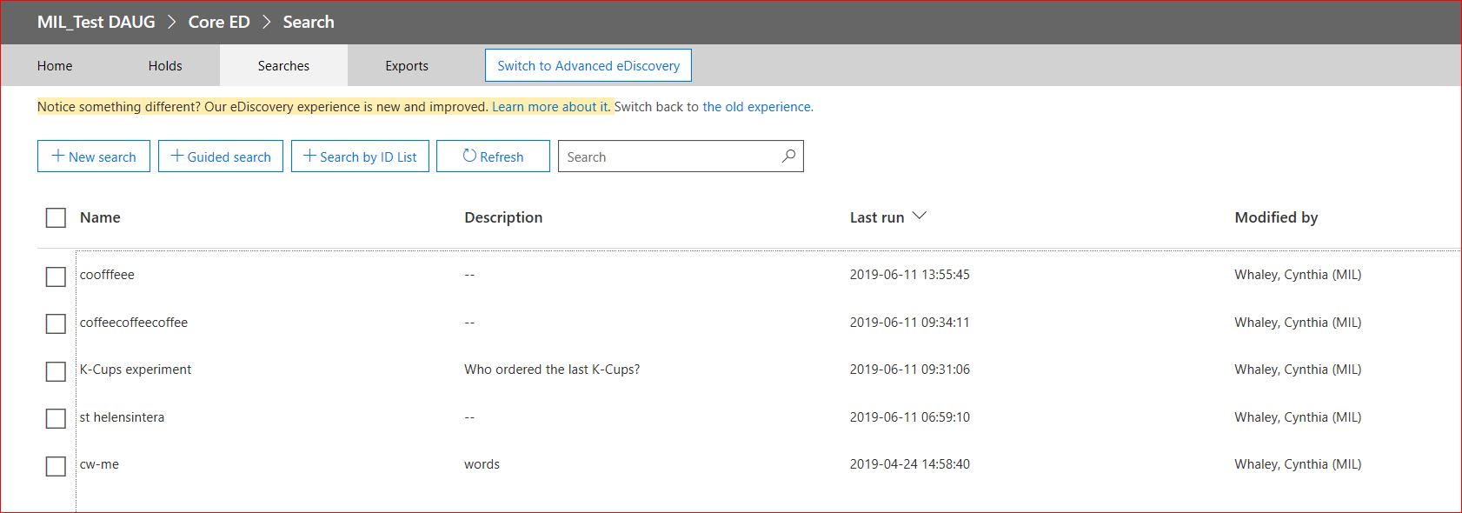
Dashboard showing multiple searches in one case. Note the description is optional but can be useful.

Slide 20
3 options to start a search:
1. New – fresh template
2. Guided – similar to the Hold search feature/ a “wizard” guide
3. ID List – email only; If you're unable to determine if an item is responsive to an eDiscovery request based on the metadata in the Results.csv or Unindexed Items.csv files, you can use an ID list search to find, preview, and then export that item to determine if it's responsive to the case you're investigating. ID list searches are typically used to search for and return a specific set of unindexed items. CSV file must be prepared for ID list search.

Slide 21
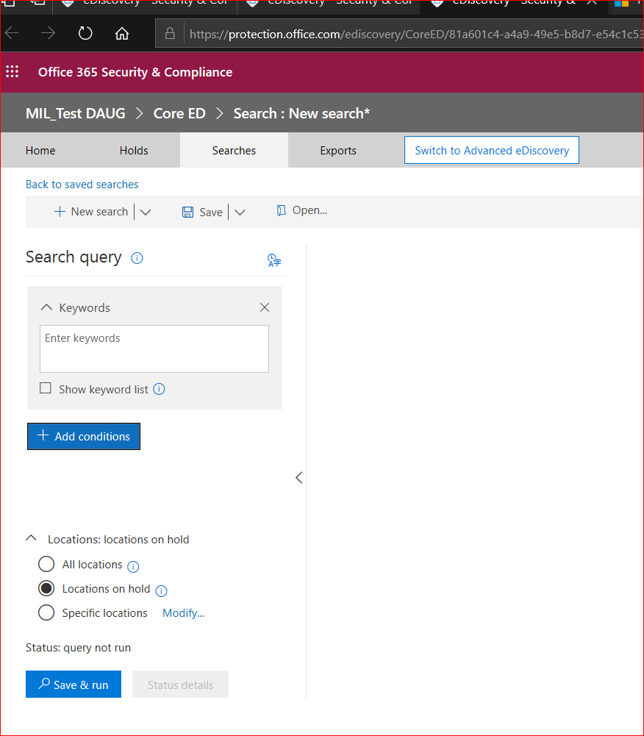
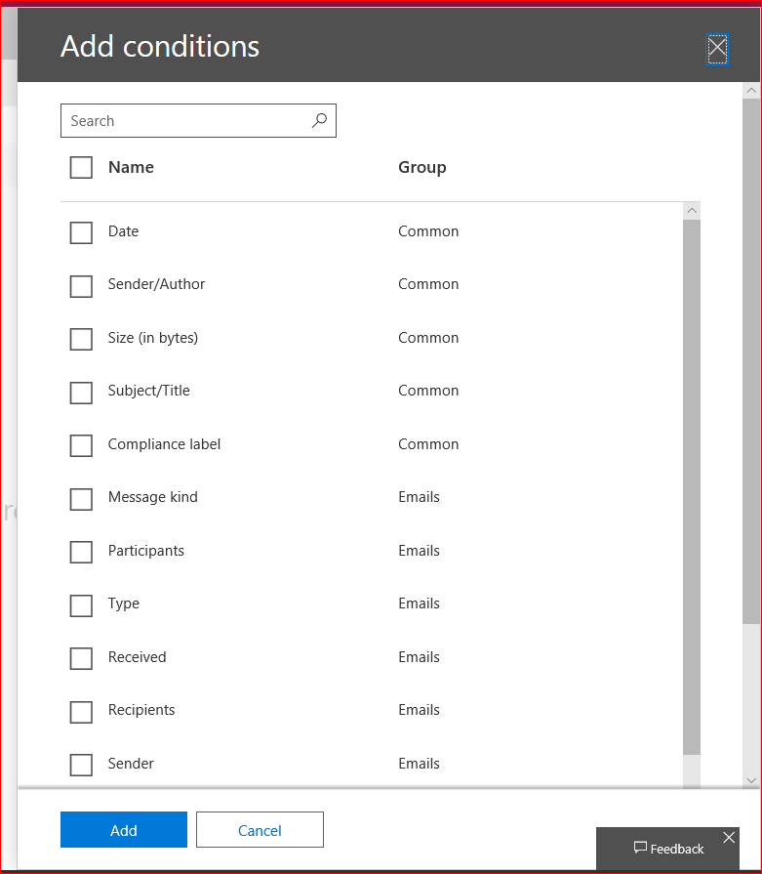
Search criteria
All search names must be unique. 0365 does not allow for multiple names duplicated.
Add/select as many filters as desired.
NOTE – you cannot search against previous searches to narrow the results. Narrow by date ranges and always start a new search if you want to show the searches performed. It is possible to over-write a search when changing the parameters.

Slide 22
More tips on searches
Boolean operators
Leave keyword box empty = all content searched within specified location(s).
Keyword list = each row connected by logical operator similar to “OR”.
Keyword phrase (surrounded by parentheses) in a row.
Keyword searched limited to 20 rows in the list.
Option to search specific locations (emails, SharePoint, OneDrive, Teams)
Option to search against Holds
Searching OneDrive – you must have the exact URL per each OneDrive
More information: https://docs.microsoft.com/en-us/office365/securitycompliance/content-search

Slide 23

Previewing search results
View results from search. Note the 20 pages of results.
Unindexed items are not previewed but will be exported
Preview limited to 1,000 items
Preview limited to 100 items per mailbox, 200 items per SharePoint and OneDrive locations

Slide 24
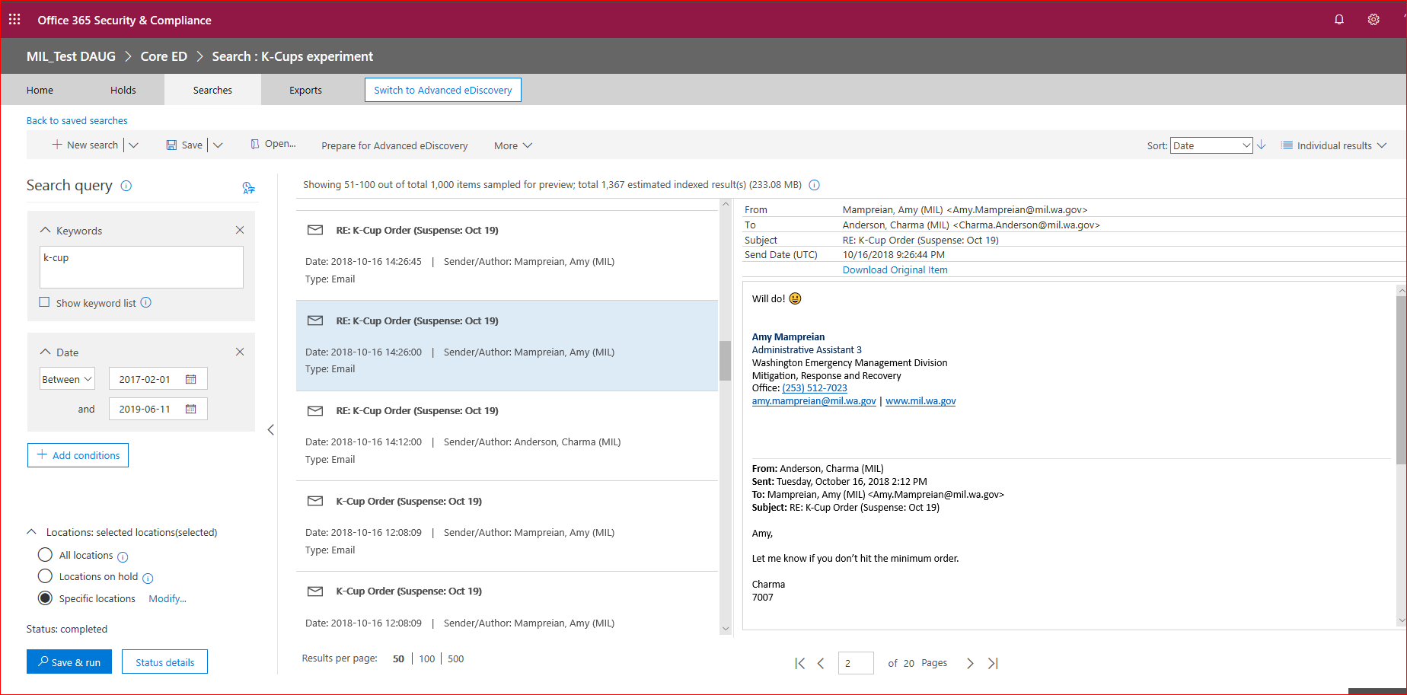
Results from search: Preview View

Slide 25
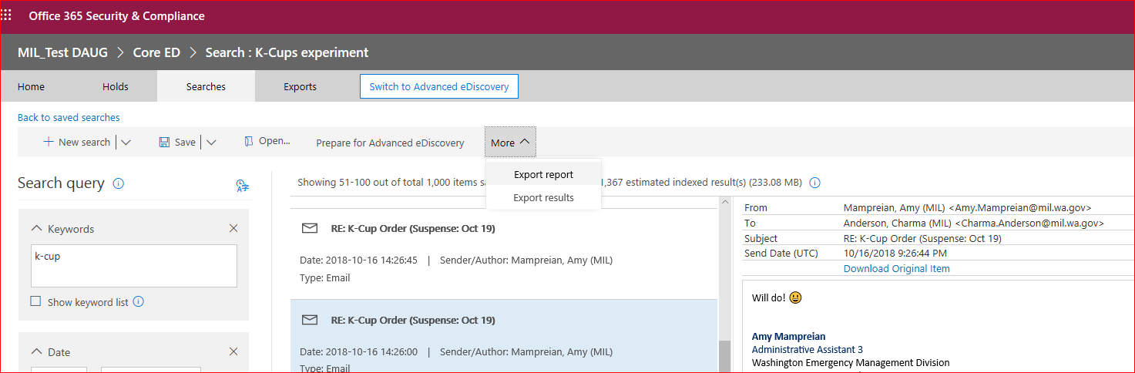
Next Step –export the search results
The Report shows the search performed. The Results are the actual records.

Slide 26
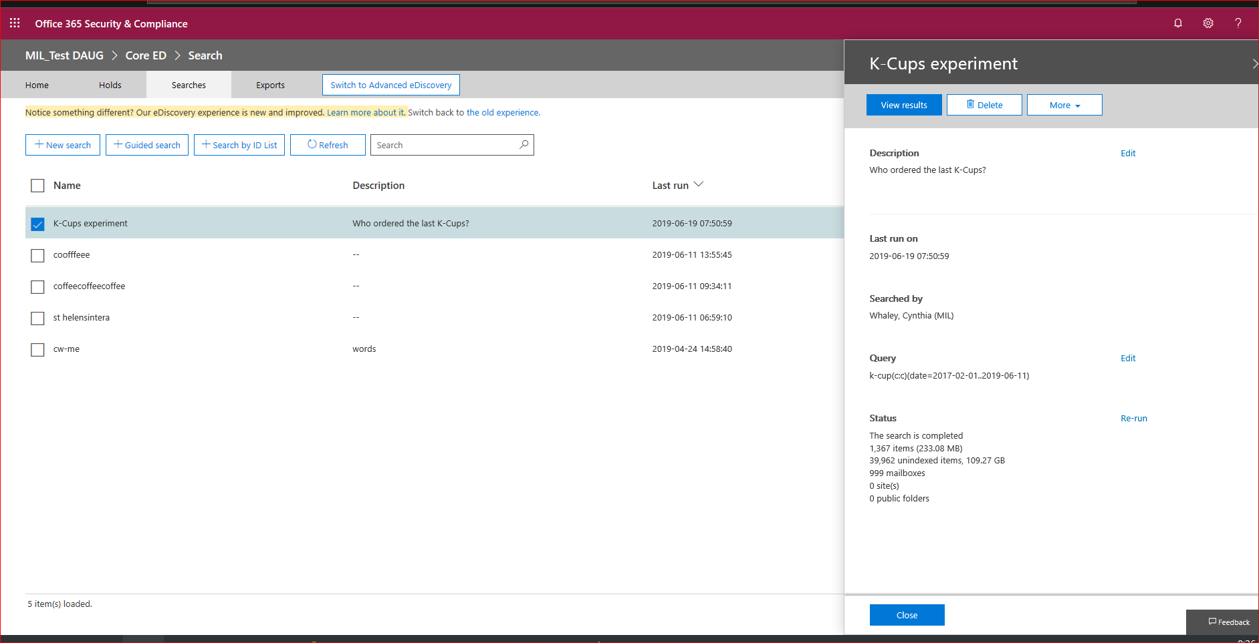
Back at the Ranch….
Right-click on any search to see the details of the search.
More menu: Also use to export from drop-down.

Slide 27
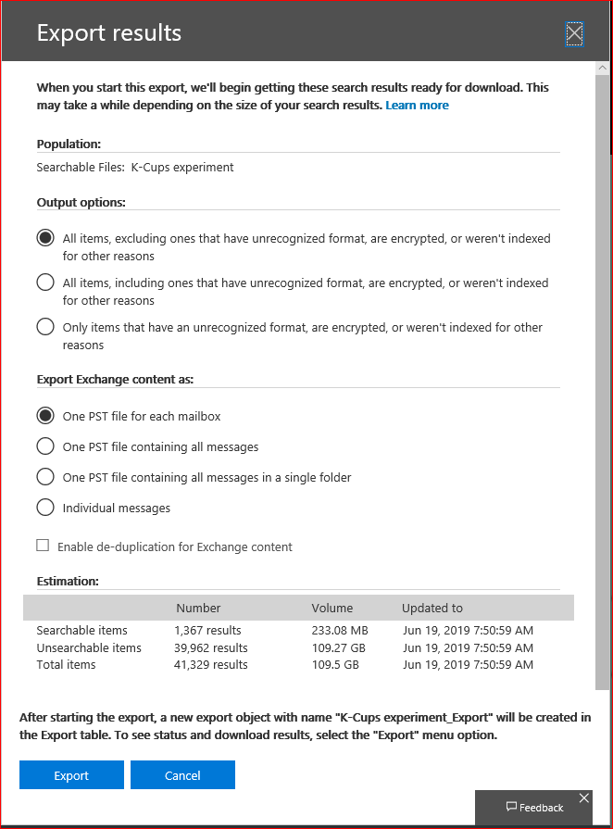
“Decisions, decisions…”
How do you want to export?
Only export using Edge or I.E. – not Chrome or Firefox (per Microsoft)
Options to exclude or include unindexed items.
PST or individual emails
De-duplicate
SharePoint and OneDrive export as the documents they are – excel, pdf, Word, etc.
To export the records from the Search to the Export [tabs], it takes only a few moments, depending on the amount of data.

Slide 28
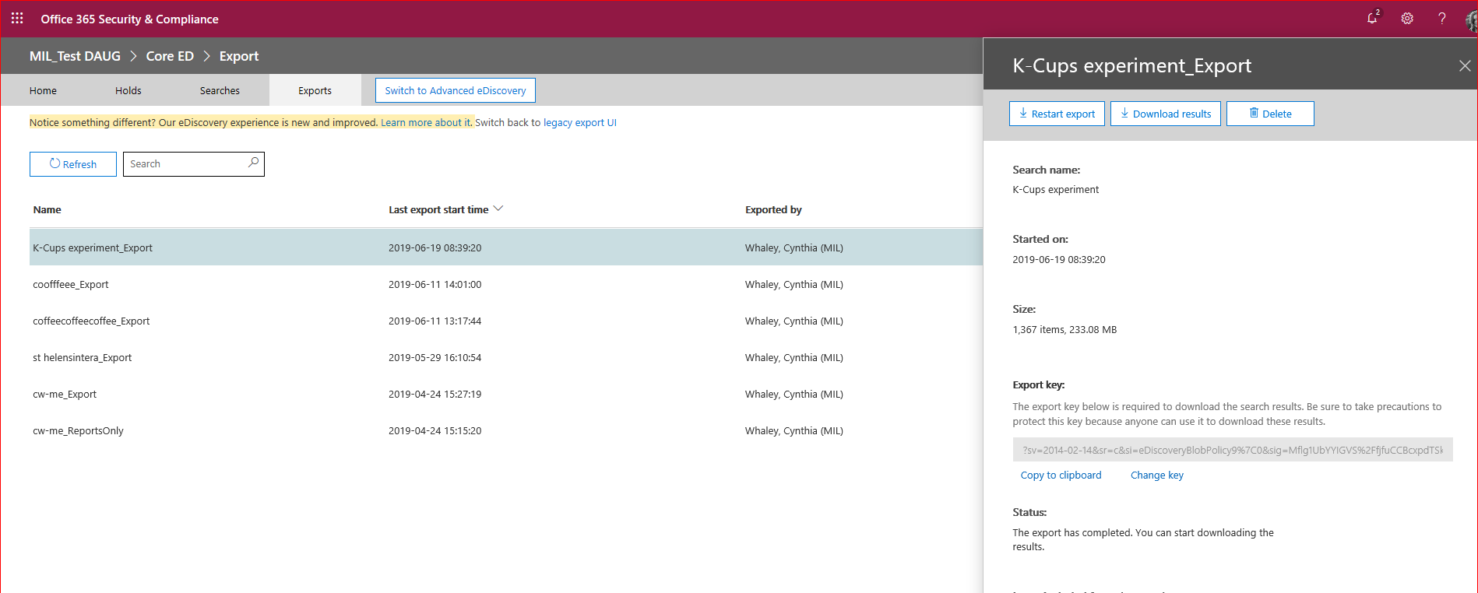
Export tab: Right-click to select to download the records from 0365 to an outside location (of your choice).

Slide 29
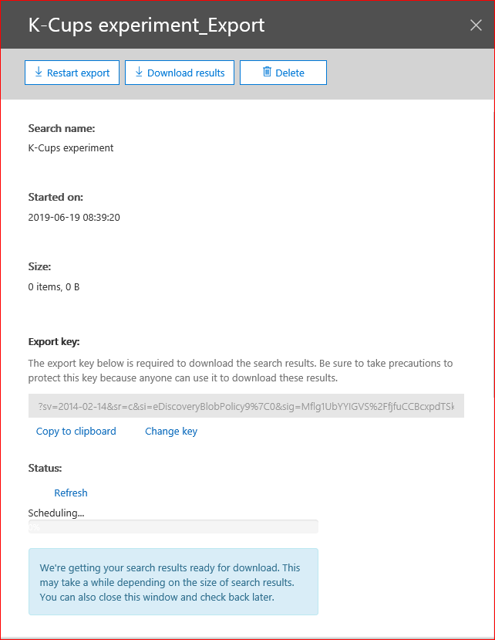
Downloading
The Export Key is the tool to export records out of 0365.
Either copy the link or select Copy to Clipboard.
Depending on the size of the download, this may take up to several hours to complete the download – sometimes overnight.

Slide 30
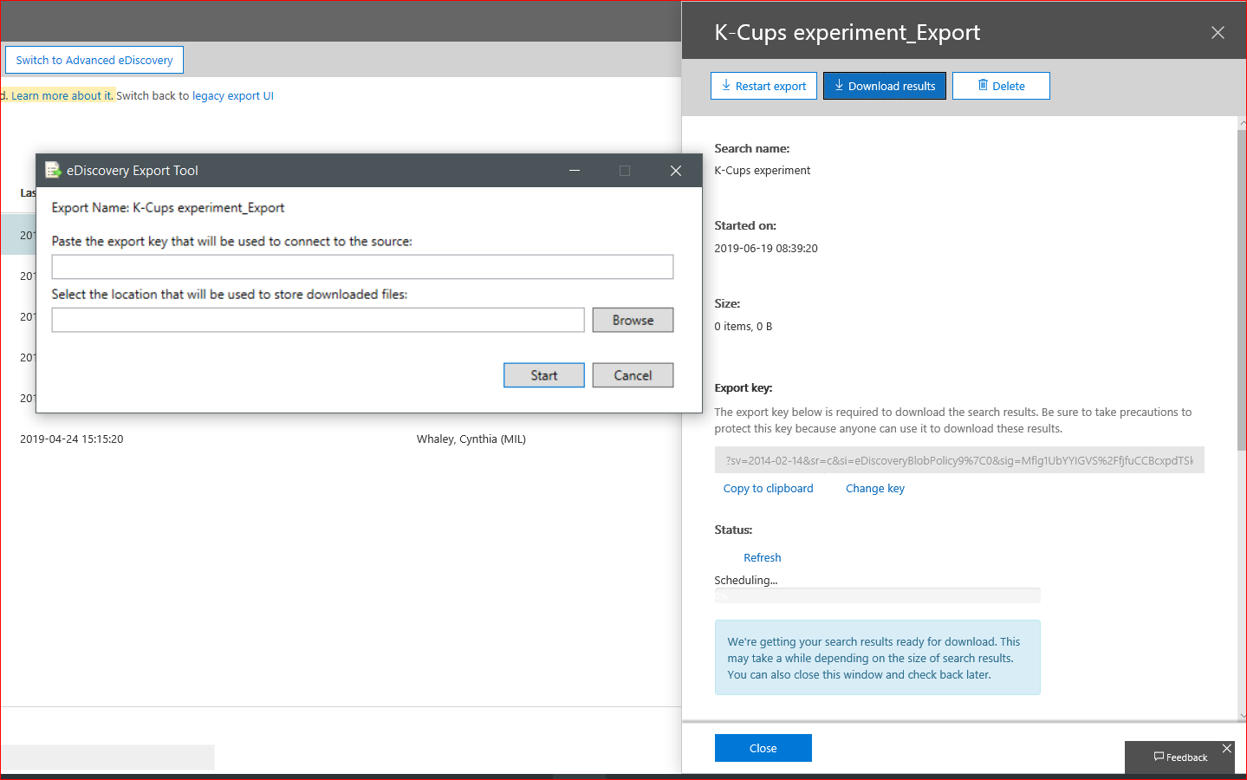
Downloading Continued
After copying to clipboard, paste link into export tool and choose location to save to.

Slide 31
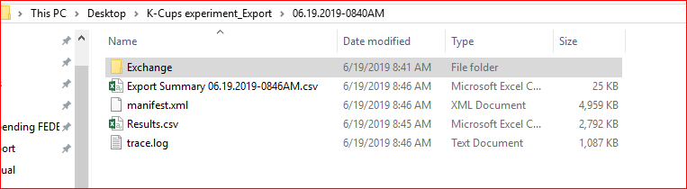
Results of export
Expect to see several folders containing Metadata, search information, audit tracking, as well as the records.

Slide 32
Now what?!?
Review the emails by loading pst into your Outlook and sort by category/ date/ sender/ etc. Save in a location of choice.
Review the SharePoint and OneDrive files in exported location or move as needed.
Tip – in order to preserve the search results, export searches immediately to avoid risks due to 0365’s constantly changing environment (real-time).
Tip – if you run a search and re-visit at a later date, the results will change due to the 0365 environment. The previous search results will have expired and you will need to re-run.

Slide 33
Advanced eDiscovery is coming….soon(?)
Advanced eDiscovery will be an add-on cost to agencies
Possibilities: analytics, review, redaction, searches with exclusion, Hold tags, OCR, Legal Hold Communications to staff, annotations, near duplications….

